Slide 1
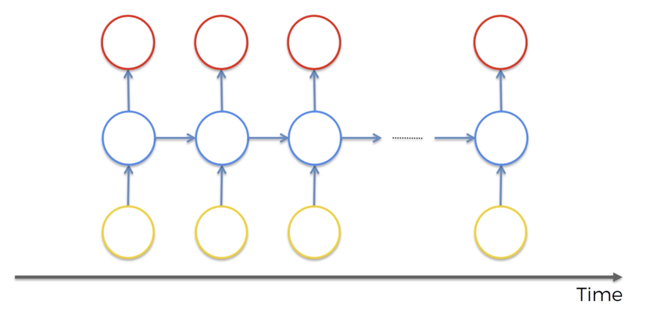
SIMPLIFIED STRUCTURE OF AN RNN ILLUSTRATED WITH A TRANSLATION EXAMPLE
OUTPUTS
Shakira
es
genial
<END>
NEURONS
The same network receiving its own output from the previous step
INPUT SEQUENCE
Shakira
is
great
<END>

Slide 2
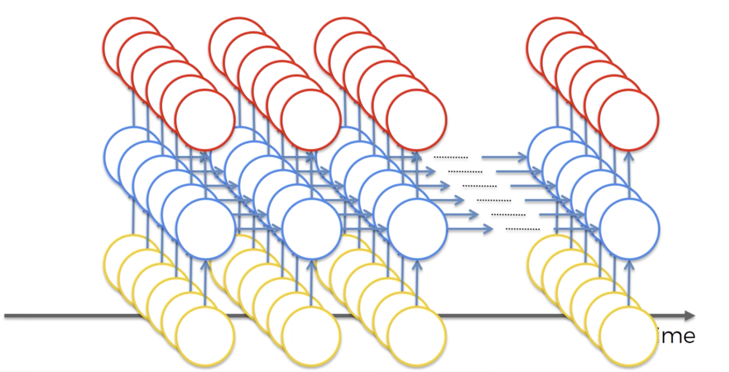
RNNs can be multiple layers deep, taking multi-dimensional input
Shakira
es
genial
Named entity tags
/B-PER
/O
/O
Part of speech tags
Noun
Verb
Adj
Words
Shakira
is
great

Slide 3
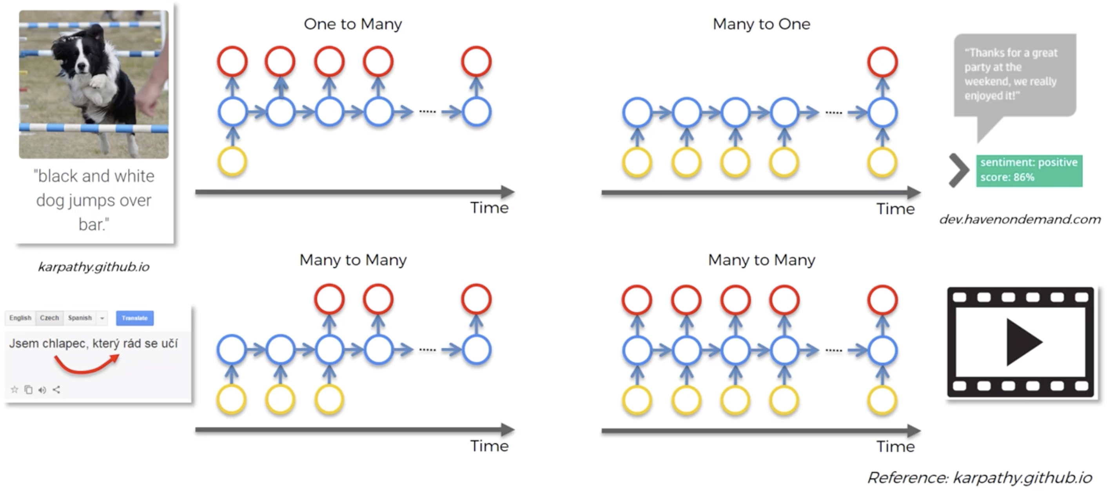
Describing an image
Sentiment Analysis
One output (the sentiment score)
One input (the image)
Translation
Description of video

Slide 4
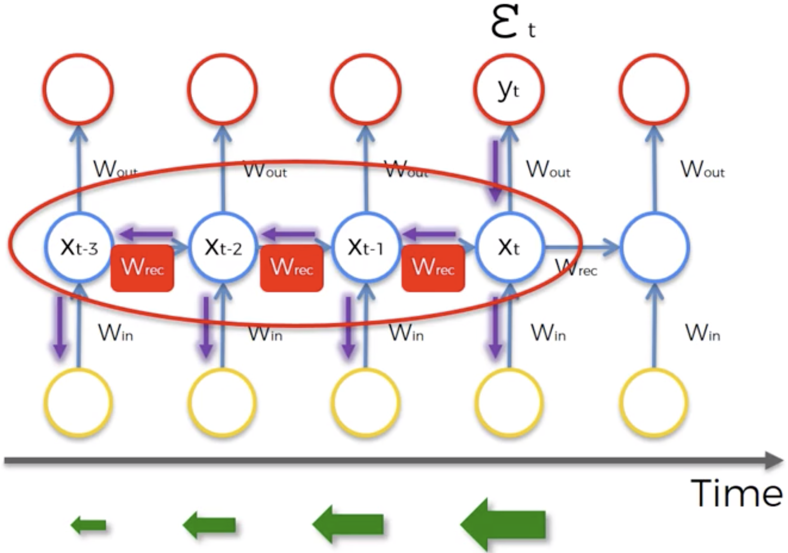
Illustration of the Vanishing Gradient Problem in an RNN
Recurrent Neurons
Input Neurons
Gradient
The gradient caused by the error at step “t” is very small when we need
to update the weights of ”t-3”.

Slide 5
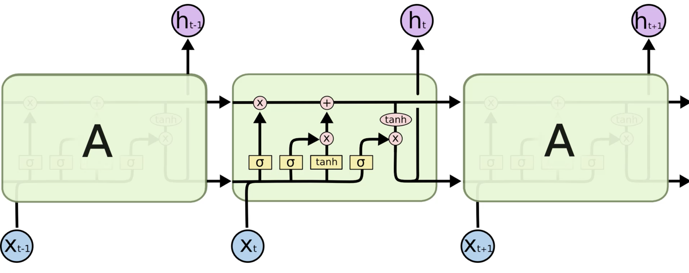
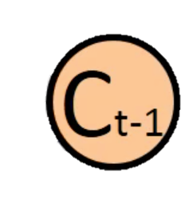



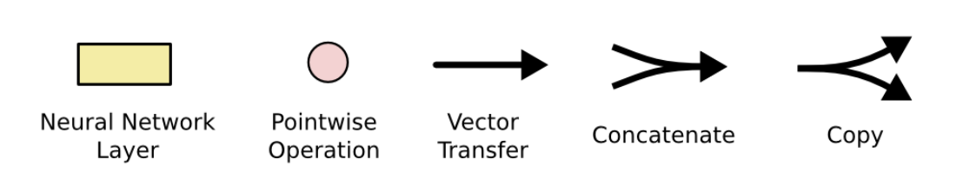
An LSTM repeating group: - Takes 3 input vectors (Ct-1, ht-1, Xt) - Produces 2 output vectors (Ct, ht)
The memory from the previous step
The output from the previous step
The input from this step
Fully connected single layer
Weights are learned
The number of neurons is a hyper parameter, but defines the dimensions of ht and Ct
(element by element)
e.g. ht-1 concat xt = [ht-1, xt]

Slide 6
Memory Pipeline: The core idea
The information flows easily and mostly unchanged across multiple steps.
Changes to the memory only happen when determined by the gates.
The derivative of this is close to 1 (no gradient vanishing or explosion).

Slide 7
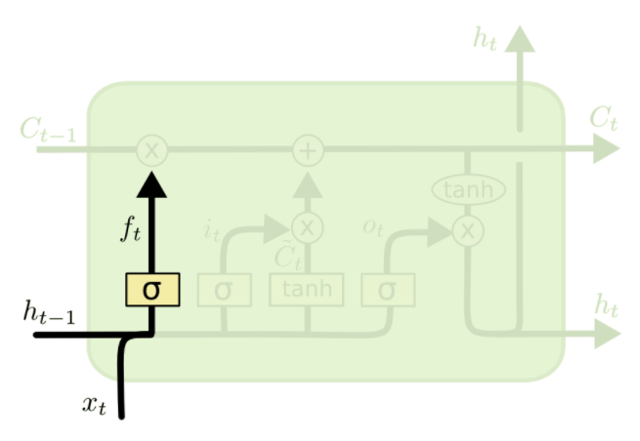
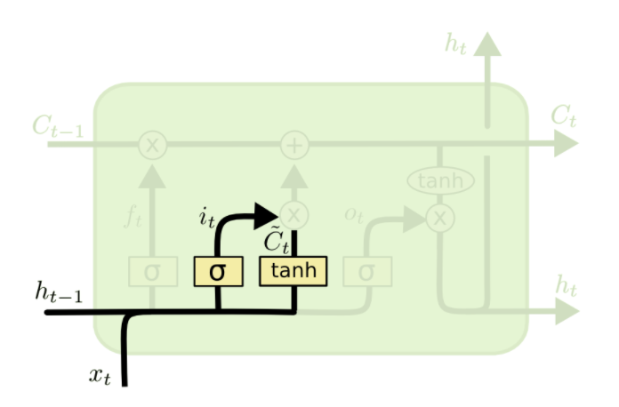
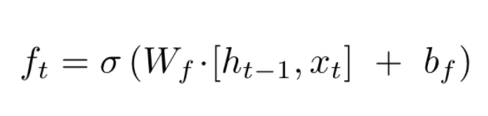
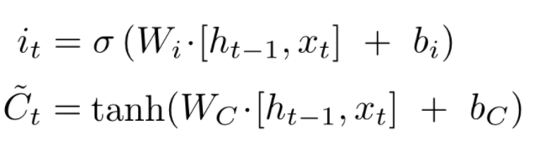
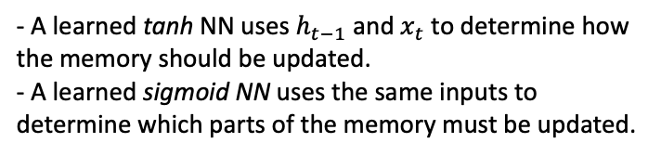
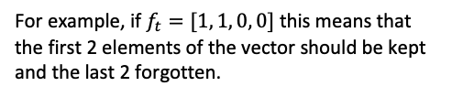
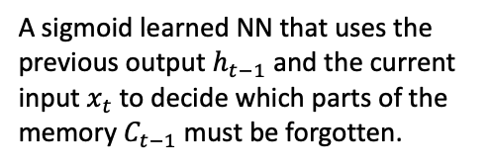
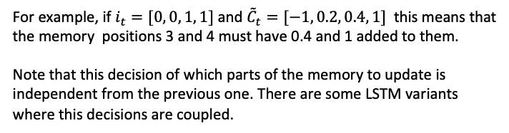
1. Decide what to forget
2. Decide what to commit to memory
A sigmoid learned NN that uses the previous output $h_{t−1}$ and the current input $x_{t}$ to decide which parts of the memory $C_{t−1}$ must be forgotten.
- A learned tanh NN uses $h_{t−1}$ and $x_{t}$ to determine how the memory should be updated.
- A learned sigmoid NN uses the same inputs to determine which parts of the memory must be updated.
For example, if $f_{t}=[1, 1, 0, 0]$ this means that the first 2 elements of the vector should be kept and the last 2 forgotten.
For example, if $i_{t}=[0, 0, 1, 1]$ and ${\tilde{C}}_{t}=[−1, 0.2, 0.4, 1]$ this means that the memory positions 3 and 4 must have 0.4 and 1 added to them.
Note that this decision of which parts of the memory to update is independent from the previous one. There are some LSTM variants where this decisions are coupled.

Slide 8
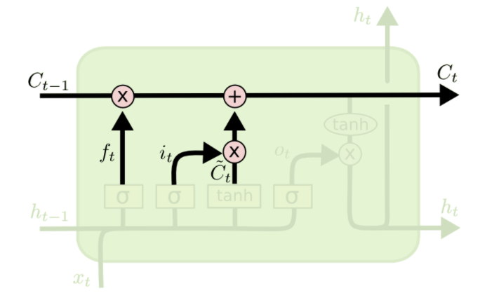
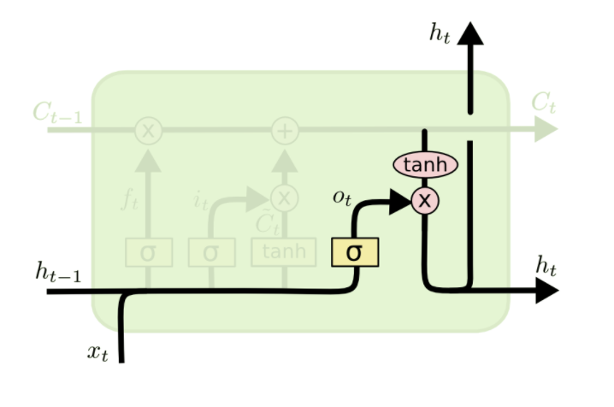
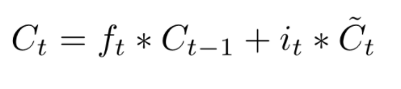
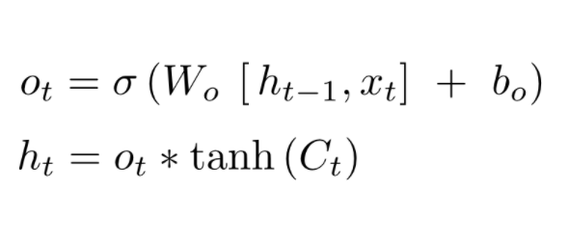

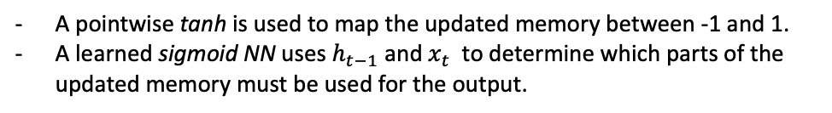
3. Commit to memory
4. Calculate the step output from the updated memory
Get a new $C_{t}$ by modifying $C_{t−1}$ based on the previous steps.
A pointwise tanh is used to map the updated memory between -1 and 1.
A learned sigmoid NN uses $h_{t−1}$ and $x_{t}$to determine which parts of the updated memory must be used for the output.
Not everything that is flowing through Ct is relevant for the output of a step. For example, in an NLP problem, if xt is a subject, this step might decide to output if the subject is singular or plural to inform the conjugation of the verb that might come in the following step.

Slide 9
All batches use 3 features per time step (i.e. in case of NLP problems, word embeddings of size 3)
0.1 | 1 | 0.33
0.2 | 0.1 | 0.4
0.79 | 0.2 | 0.4
0.2 | 0.55 | 0.2
0.2 | 1 | 0.33
0.4 | 0.1 | 0.4
0.99 | 0.2 | 0.4
0.2 | 0.55 | 0.2
0.3 | 1 | 0.33
0.5 | 0.1 | 0.4
0.09 | 0.2 | 0.4
0.2 | 0.55 | 0.2
the | black | cat
the | brow | fox
a | red | dog
some | other | stuff
This batch has 4 training samples
Batch 2
All batches uses 3 features per time step (i.e. in case of NLP problems, word embeddings of size 3)
3 time-steps per sample in this batch
0.7 | 0.2 | 0.4 | 0.1
0.2 | 0.55 | 0.2
0.2 | 1 | 0.3 | 0.5
0.4 | 0.1 | 0.4
Batch 1
0.3 | 1 | 0.33 | 0.6
0.5 | 0.1 | 0.4
a | man | in | red
the | fan | is | bad
This batch has 2 training samples
Not part of the actual input, just there to help the example make sense
4 time-steps per sample in this batch

Slide 10


